Slide 1

Predicting the crime rate of Chicago
Jingwei Hu
August 1st 2019

Slide 2

Background
Assume that we want to run our businesses, we would concern about the crime rate of the possible site.
Figure out the factors that would have an impact on the crime rate in the city of Chicago.

Slide 3
Data acquisition and cleaning
Household density, unemployed rate, average incomes in the neighborhood.
All the venues and its category in the neighborhood.

Slide 4
Data Source
venues and their type and location in every neighborhood will be obtained using Foursquare API
the category hierarchy of venues will also be obtained from Foursquare API
the demographic data includes civilian, labor force, unemployment, household, and income will be obtained from US government official website.
the crime data occurs in the city of Chicago will be collected from this source.

Slide 5

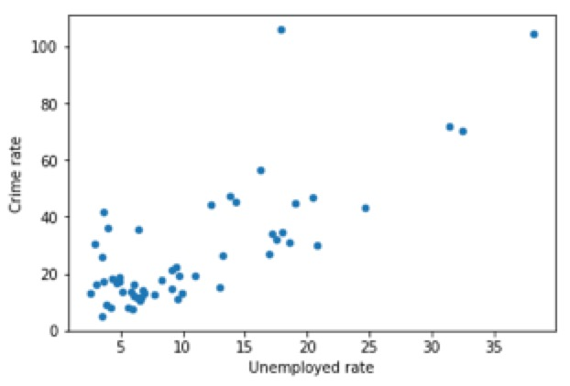
Analysis
Unemployed rate positive related to the crime rates. The Pearson correlation coefficient between crime rate and unemployment was 0.772.

Slide 6
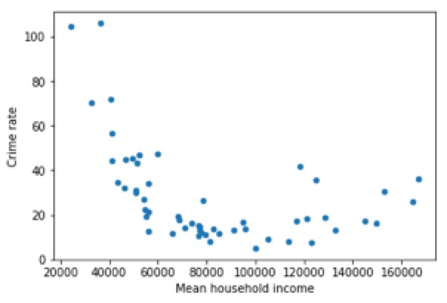
Analysis
Income negative related to the crime rates.
This correlation is a non-linear relation, like a bowl.

Slide 7
Predictive Modeling
Curve fit
Unemployed rate, household density, and mean household income
'College & University','Professional & Other Places','Shop & Service','Travel & Transport','Outdoors & Recreation','Nightlife Spot','Food','Venue density'

Slide 8
Predictive Modeling

Slide 9
Predictive Modeling

Slide 10
Results and Discussion
Unemployed rate have the strongest negative linear impact on the crime rate, and the influence from household income is a little bit different.
It seems that when an area is poorer it would have higher crime rate, meanwhile when an area is richer it is also more likely to have criminal events. But the slope of the two directions are not the same.
The venue data could help to refine the model.

Slide 11
Related data source
Foursquare API
[https://www.census.gov]
[https://factfinder.census.gov]
[https://data.cityofchicago.org]

Slide 12
Thanks！

